Slide 1
How to Process an Interactive GPS Report Training Presentation

Slide 2
How to Process a GPS Report
To access the student’s degree audit report, point your browser to my.ucf.edu. Enter your NID and Password. Click

Slide 3
How to Process a GPS Report
CLICK “Staff Applications”

Slide 4
How to Process a GPS Report
Click
“PeopleSoft SA/HR”

Slide 5
How to Process a GPS Report
SELECT “Main Menu”

Slide 6
How to Process a GPS Report
Open “GRAD Custom” Folder
GRAD Custom

Slide 7
How to Process a GPS Report
SELECT “Graduate Plan of Study (GPS)”

Slide 8
How to Process a GPS Report
Enter your student’s ID number or First and Last Name here. Click Search.

Slide 9
How to Process a GPS Report
Select the appropriate
Program then Click

Slide 10
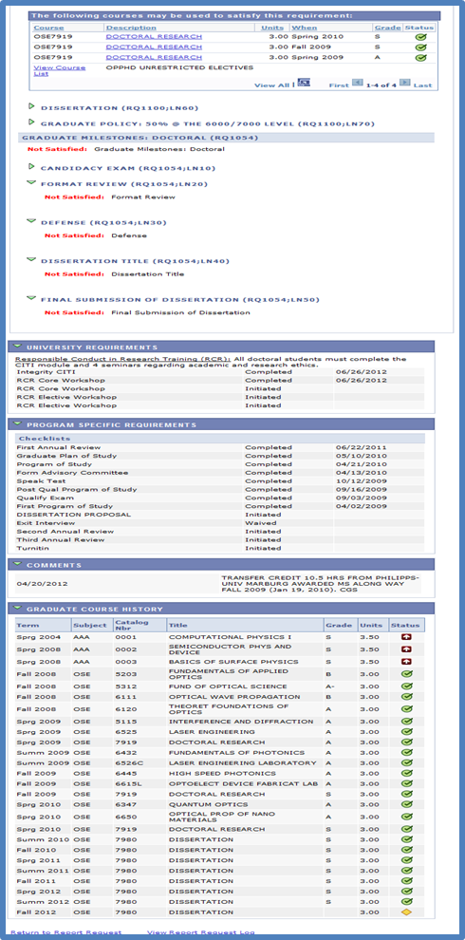
How to Process a GPS Report
Your Complete Degree Audit

