Slide 1
How to Process a “What IF” Report
Training Presentation

Slide 2
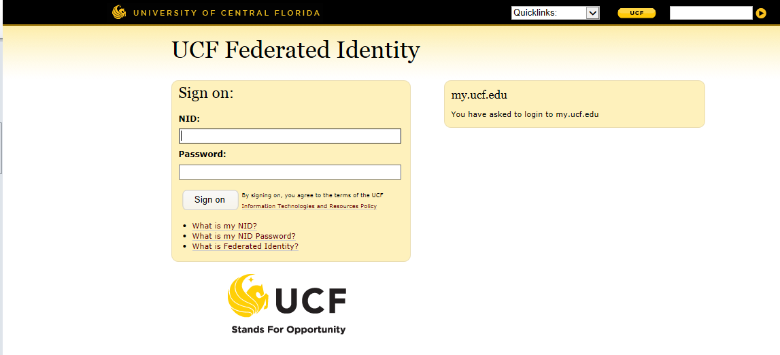
How to Process a WHIF Report
To sign on ENTER your “NID and Password”

Slide 3
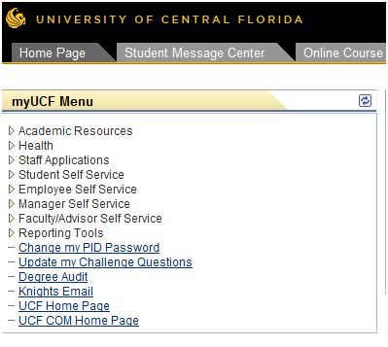
How to Process a WHIF Report
SELECT “Student Self Service”

Slide 4
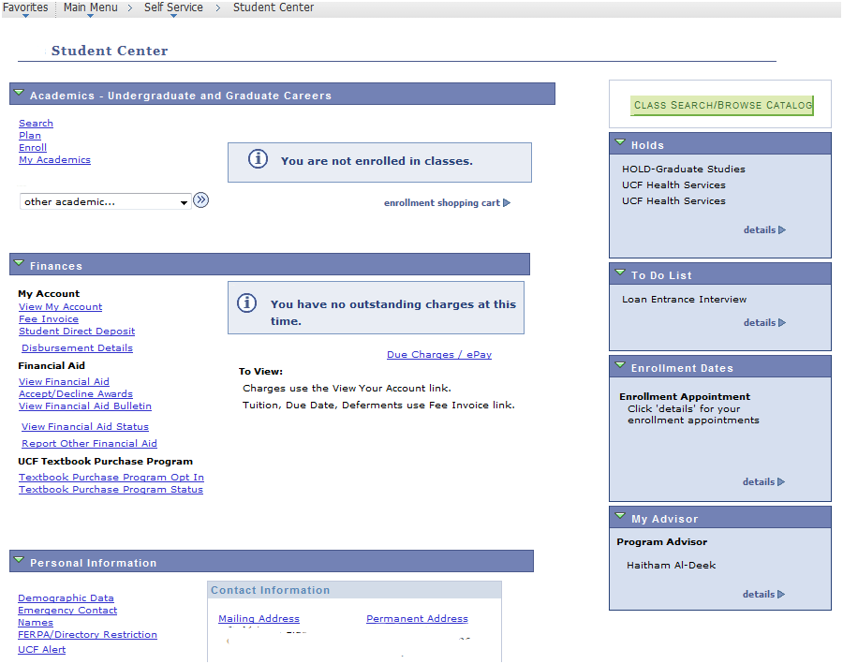
How to Process a WHIF Report
Knight
SELECT “My Academics”

Slide 5
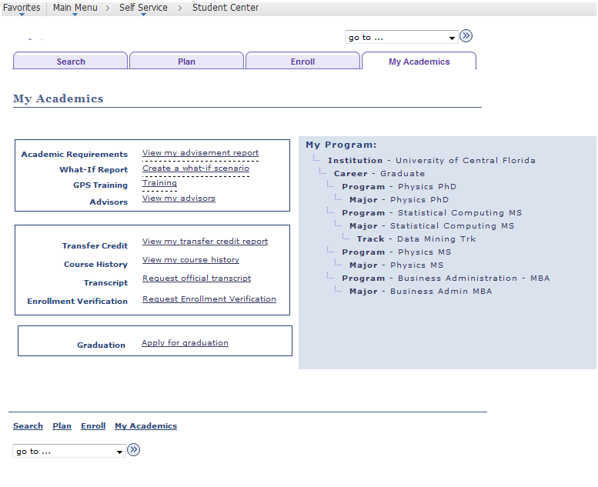
How to Process a WHIF Report
Knight Rider
SELECT “Create a what-if scenario”
Please note that you may also access the What-If Report from the Advisement report link

Slide 6
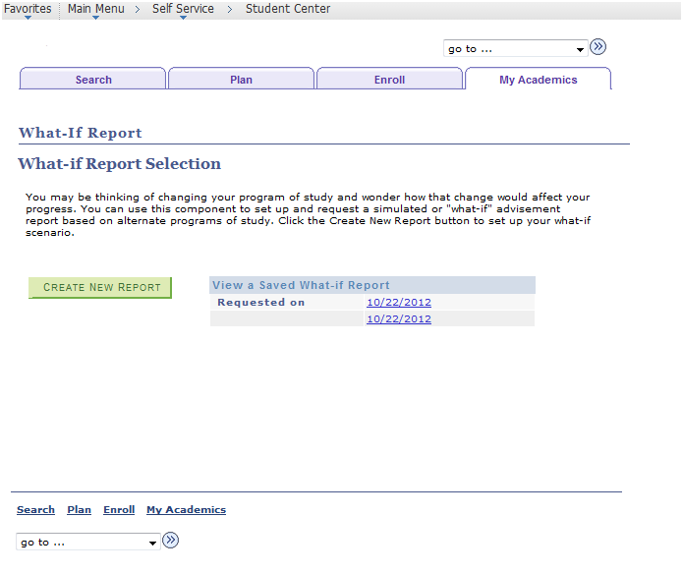
How to Process a WHIF Report
Knight Rider
SELECT “Create New Report”

Slide 7
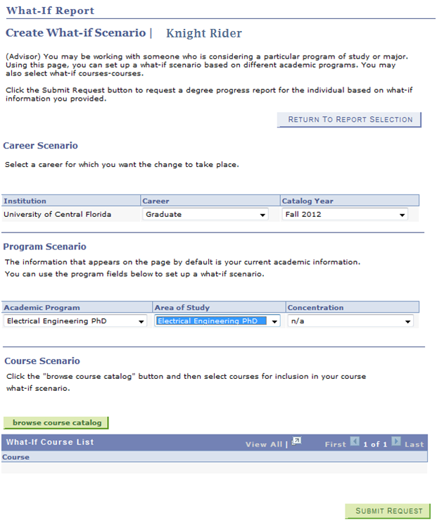
How to Process a WHIF Report
You may change your catalog year here
Note that your current active program information will populate in this area. To Process a WHIF you must change the “Academic Program” and the “Area of Study” to the program you intend to simulate
If you would like to simulate a course or courses, select “browse course catalog”
Click “Submit Request”

Slide 8
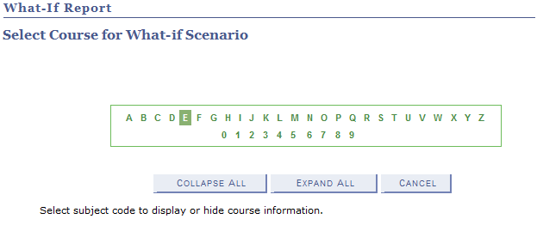
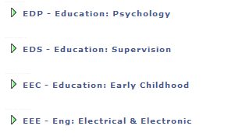
How to Process a WHIF Report
You may select your Subject Code / Program to access to the course information.

Slide 9
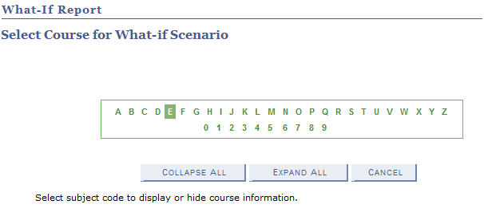
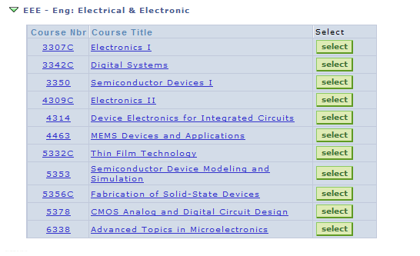
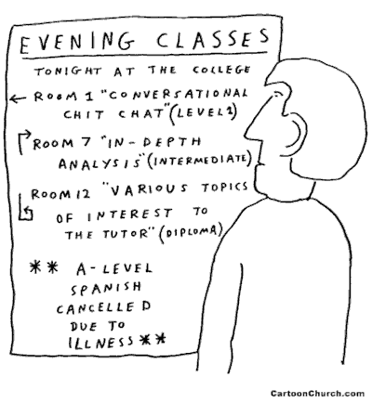
How to Process a WHIF Report
Make sure to push the Select button to select a course.
Note: Should you hit the hyperlink, it will take you to the student shopping cart for enrollment.

Slide 10
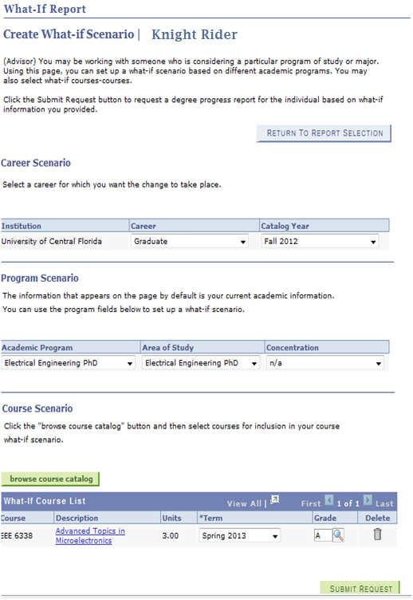
How to Process a WHIF Report
After selecting the WHIF course, If you would like to add a “WHAT IF” grade you may do so in the grade section.
Click “Submit Request”.

Slide 11
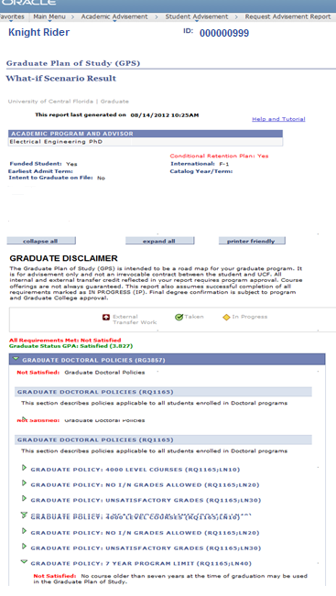
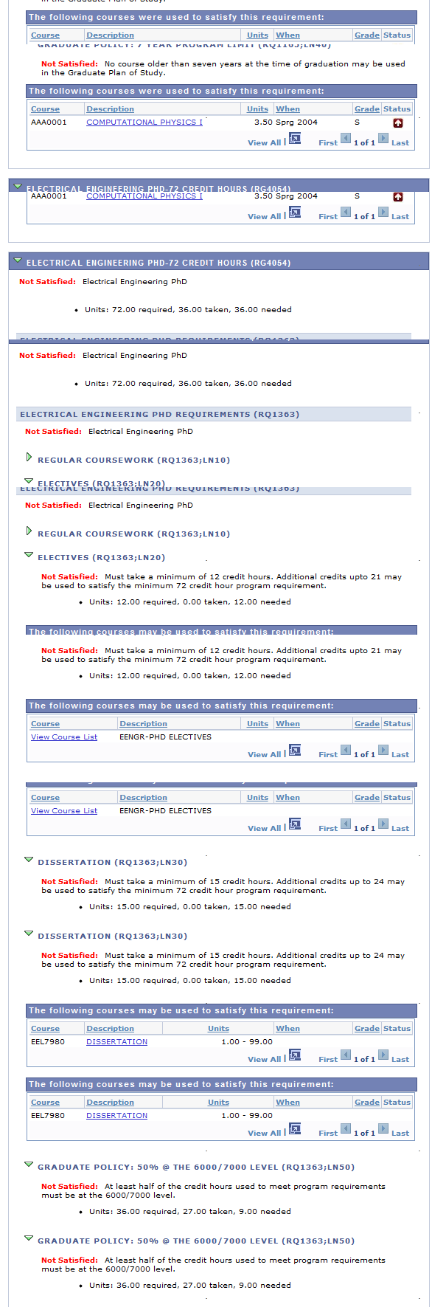
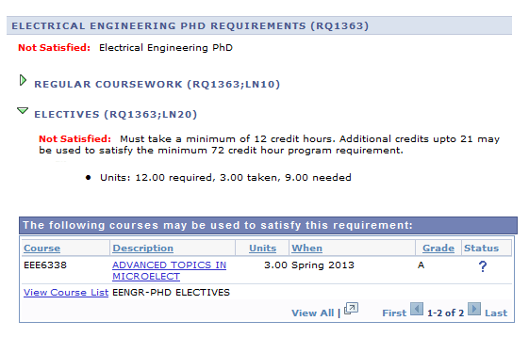
How to Process a WHIF Report
Here is your full Report.
These are the requirements you would need to satisfy in order to graduate.
And there we have it!

